Slide 1
Waves of Behavior Therapy
By:
Hunter King, M.A., M.Ed.
Lauren Martone, M.A.

Slide 2
Agenda
First order change vs. Second order change
Context surrounding each shift
Third wave behavior therapies
Dialectical Behavior Therapy (DBT)
Acceptance and Commitment Therapy (ACT
Mindfulness-based Cognitive Therapy (MBCT)
Practical differences between third and second waves therapies

Slide 3
First Order Change
Form and Frequency
Second Order Change
Function / Purpose
Notes:
In the second wave, irrational thoughts, pathological cognitive schemas, or faulty information processing styles would be weakened or eliminated through their detection, correction, testing, and disputation, much as anxiety was to be replaced by relaxation in the first wave.

Slide 4
Form
Purpose
Effective?
Function
Practical Joke
Art
Learning
Notes:
Form
Does this chair look like it has any purpose?
Can you think of any contexts in which this chair functions effectively?
Function
Practical joke
Art exhibition
Demonstrate design flaws in shop class
Compensation claim

Slide 5
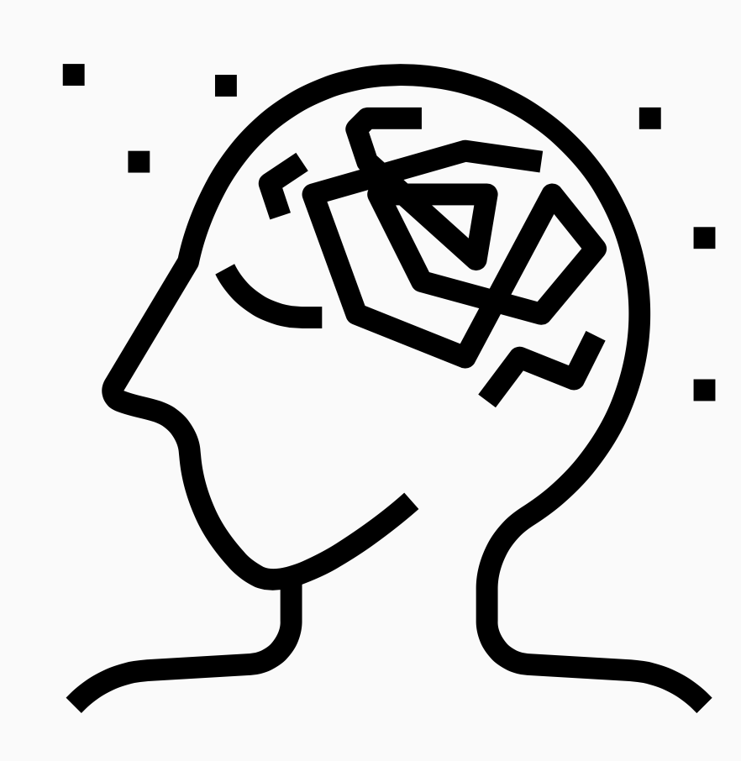
Thought:
“If I don't practice every day, I will fail.”
Function
Work/life balance
Anxiety
Relations
What about…
Form
Increased Pay
Job Status
Positive Feedback
Notes:
Deliberate, fun based on preferences . Ensure equal spacing; icons and pictures vs. words

Slide 6
First WaVE BEHAVIOR THERAPY: 1940-1950s
Alternative to psychodynamic approach
Behavioral principles:
Operant conditioning
Respondent conditioning
Contingency management
Exposure and response prevention
Systematic desensitization
Focus on:
Discrete behaviors
Inpatient adults with severe mental illness
Children with anxiety, skill deficits, or behavioral concerns
Notes:
Pictures/icons

Slide 7
The shift…
Cognitive Revolution
(2)
Thoughts and feelings
(3)
Computer metaphor
(1)
WWII
PTSD
Notes:
Although exposure-based interventions have support for PTSD, they tend to have more of an effect on hyperarousal and re-imagining, as opposed avoidance. Some believe that is because veterans perceived strict exposure as scary, intimidating
This let us know that thoughts and feelings were too important to ignore.
The computer metaphor gives us a way to understand how thoughts and feelings might be contibuting to a client's problem

Slide 8
SEcond WaVE BEHAVIOR THERAPY: 1960s-1980s
“…techniques designed to modify the dysfunctional beliefs and faulty information processing characteristic of each disorder.” (Beck, 1993, p. 194).
Second Wave
Focus
Cognitive processes & schemas
Thought content
Modalities/Strategies
Rational Emotive Therapy
Cognitive Therapy
Notes:
Now we have this mechanistic account of human language and cogntion. This allows us to identify the problem, and change the issue so that is is less problematic.

Slide 9
Similarities and Differences Between 1st and 2nd waves
First Wave
Second Wave
Form and Frequency
First Wave
Second Wave
Language and Cognition
Notes:
Change in: frequency, intensity, location, duration, etc.
Nothing prohibited the use of first order change methods aimed at overt behavior, thoughts, etc.

Slide 10
The Shift…
Component analyses
Therapy outcome
Too mechanistic
Less federal Funding
No additive benefit compared to behavior therapy
Change occurred before cognitive interventions
Context/
function
vs.
Form/content
Second wave behavior therapies stagnated/too targeted
(Gorton et al., 1998; Dobson et al., 2000; Ilardi & Craighead, 1994; Jacobson et al., 1996; Zettle & Hayes, 1987)

Slide 11
Third Wave Behavior Therapy: 1980s…
Merging with existing theories
Humanism; Constructivism
Big idea
Second order change
Ongoing act in process
Context and function vs. form
Mindfulness-based Cognitive Therapy (MBCT)
Acceptance and Commitment Therapy (ACT)
Dialectical Behavior Therapy (DBT)
Functional Analytical Psychotherapy (FAP)

Slide 12
Similarities and Differences between 2nd and 3rd wave
Second Wave
Third Wave
Language and Cognition
Second Wave
Third Wave
Function
vs.
Form and Frequency

Slide 13
Dialectical Behavior Therapy (DBT)
Shift thinking from
“Either or”
to
“both and”
Validate primary
vs
secondary emotions
Metaphors to promote flexible thinking
Problems afford opportunities too
Dialectics
Opposites can be integrated to form a closer approximation of the truth
Example:
Teacher with disruptive classroom
Doing the best I can BUT/AND I want to do better
Suicide and Borderline PD
Sole use of change-based strategies unhelpful
Acceptance & change strategies were the key
Linehan, 1993
Notes:
Dialectical thinking refers to the ability to view issues from multiple perspectives and to arrive at the most economical and reasonable reconciliation of seemingly contradictory information and postures.
Teacher
Given the teachers background/teaching experience, tolerance for disruption, and other contexts, they are doing the best that they can
At the same time the teacher may wish they had more resources or that they they didn’t get so frustrated
* this is the dialectial piece
You don’t want to focus too much on either statement, but equally attend to both
Validate client responses, at the same time discuss context, opposing views to help them consider dysfunction and need for change

Slide 14
Mindfulness-based cognitive therapy (MBCT)
Negative Thinking
(episode)
Prevention of depression relapse
Combination of CBT and mindfulness
Focus on awareness of and relationship to thoughts, feelings, and sensations
Mindfulness and present moment awareness
Non-judgmental
Therapy /Coping strategy
(Examine/evaluate thoughts; remission)
Potential Relapse
(low mood reactivation)
No Relapse
(thinking pattern nipped in the bud)
Relapse
(negative thinking re-established)
Notes:
MBCT overview and techniques

Slide 15
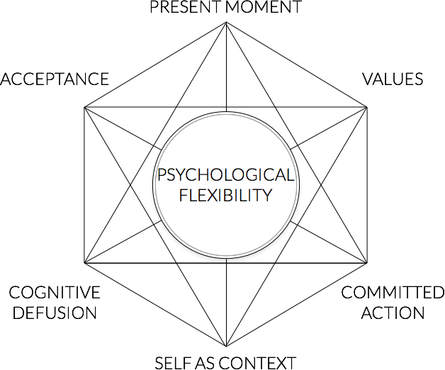
Acceptance and commitment therapy
A-C-T
Goal is psychological flexibility
Behavioral component: taking action according to your core values
A life without suffering does not exist
Notes:
Descriptions of each process

Slide 16
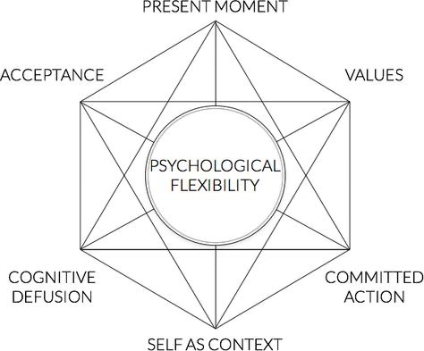
Act strategies and ideas
Creative hopelessness
Control as the problem
Transcendent sense of self
"Acceptance"
"Commitment"
Cognitive defusion
Notes:
Make sure to say ‘you wont use these words when talking with clients. You would use diff words with clients”

Slide 17
CBT
Biased information processing and maladaptive beliefs
Identify, evaluate, & modify distorted cognitions
Cognitive change
Symptom free
Theory
Therapy
Mechanism
Health
Psychological inflexibility
Defusion, acceptance, willingness, commitment, values
Psychological flexibility
Living valued life
ACT
Adapted from O'Donohue & Fisher, 2009

Slide 18
Application TO generalized Anxiety Disorder (GAD)

Slide 19
CBT
ACT
Therapy
Replace avoidance behaviors
Flexible and adaptive responding

Slide 20
CBT
ACT
Therapist
“Swimming in same stream”
Therapist as “coach”

Slide 21
CBT
ACT
Change content and/or frequency
Thoughts and emotions
Distance from private experiences

Slide 22
CBT
ACT
Goals
Eliminate automatic internal response
Reduce experiential avoidance

Slide 23
CBT
ACT
Socratic questioning, empirical tests, persuasion
strategies
Metaphors, role play, experiential exercises

Slide 24
metaphors
Person & Hammer
Beach Ball

Slide 25
“I used to think my mind was my most important organ, until I noticed what was telling me that”- Emo Philips

Slide 26
Contact us for references / Further Reading
Hunter king
Email: hunter.king@utah.edu
Lauren Martone
Lauren.martone@utah.edu

