Slide 1
Menstruation & ASD:
Aunt Flo Doesn’t Discriminate
Keely Lundy, M.Ed.
(she/her)

Slide 2
Agenda
Inclusive Language
Puberty and ASD
Menstrual Hygiene Management
Resources

Slide 3
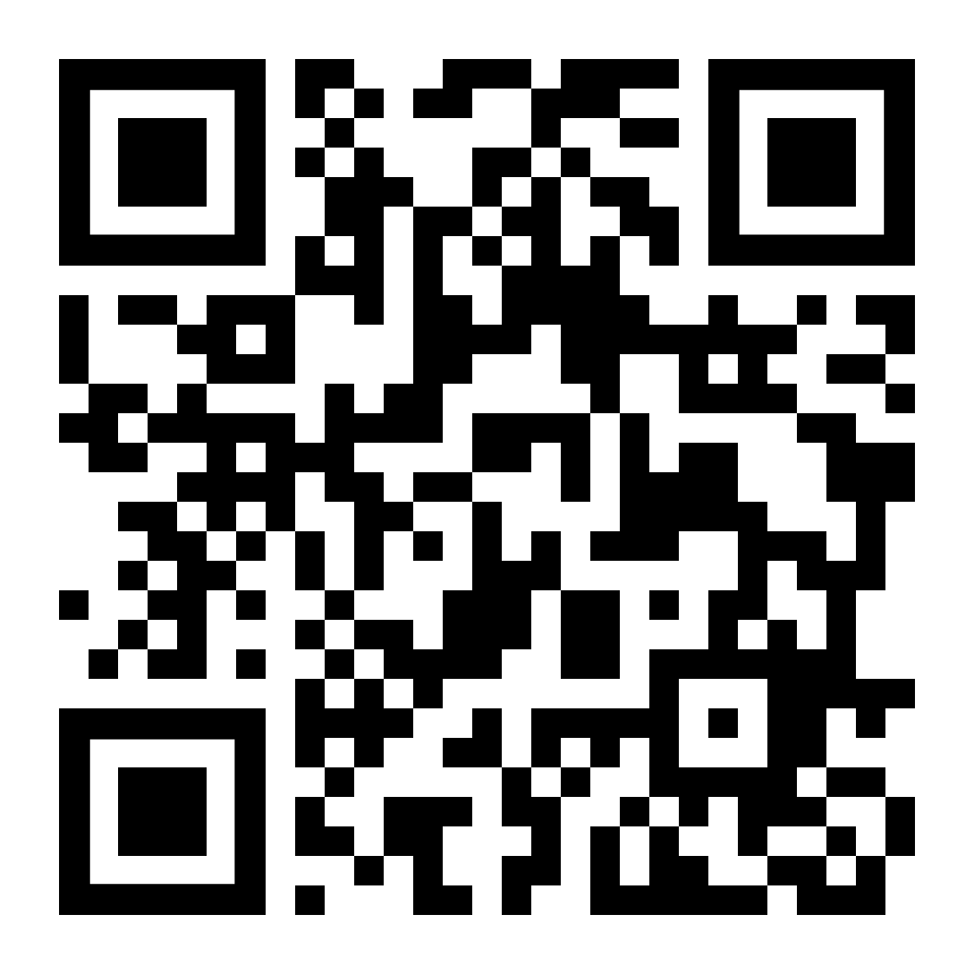
What comes to mind when you think of “Menstruation”?
PollEv.com/keelymcculla234

Slide 4
Inclusive Language

Slide 5
Menstruation = Woman
While true, cis women are the majority menstruators...they are not ALL.
“Transgender or Gender-diverse” (Warrier et al., 2020)
Adverse effects of non-inclusive attitudes and language use:
Avoiding public restrooms
Lack of appropriate and timely healthcare
1.3%

Slide 6
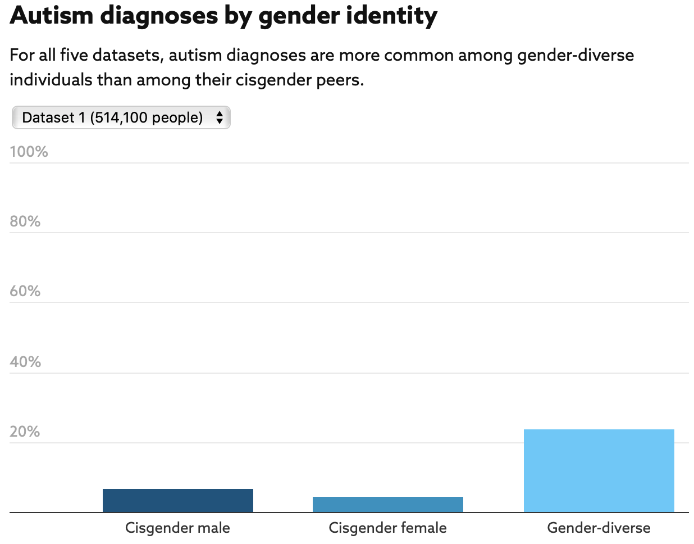
Gender-Diversity and ASD
“Transgender and gender-diverse individuals were 3.03 to 6.36 times as likely to have autism than were cisgender individuals” (Warrier et al., 2020).
These rates may be underestimated.
Why?
Less influenced by societal norms.

Slide 7
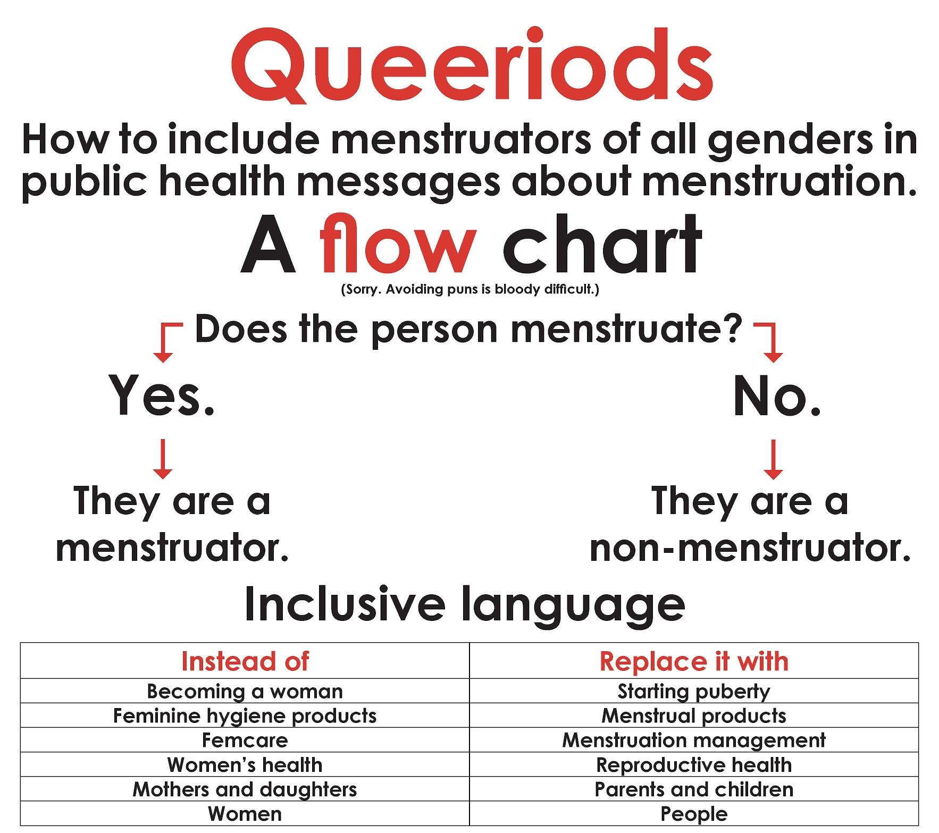
Healthcare Resource
Transgender Health Program, Salt Lake City
Inclusive Products/Companies
Boy Shorts | Period Panties | Thinx
Boxer Brief | LunaPads
Menstrual Cup Blue | Lunette
Reusable Pads | Glad Rags
Cotton Pad | Aunt Flow

Slide 8
MOVING FORWARD
Since menstruation is not strictly a women’s health issue, we will be using terms that incorporate all perspectives and every body.
“Menstruators”
“People who menstruate/have periods”
(Rydstrom, 2020; Bell, 2017, para. 5).

Slide 9
Puberty & ASD

Slide 10
Puberty & ASD
The Australian Parenting Website

Slide 11
Development
Average age of puberty onset is 11 or 12 years old.
Normal to begin anywhere from 8-14
Youth on the autism spectrum tend to start puberty 9.5 months earlier than neurotypical peers (Corbett et al., 2020).
Earlier onset of menarche
Greater likelihood of mental ill-health
Need to better prepare, educate, and support them for this transition.

Slide 12
ASD Specific Issues
Autism Spectrum Disorder:
Limited reciprocal social communication
Restricted, repetitive, and stereotyped thought and behavior (APA, 2013)
Inflexibility with change
Diminished social connectedness
Mood and behavioral abnormalities
Decreased hyperactivity
Gynecological concerns:
Menorrhagia
Dysmenorrhea
Irregular bleeding
Hygiene issues

Slide 13
The Autism Perspective
“
Overwhelmingly negative experiences, especially exaggerated sensory issues and intensified executive and emotion-regulation problems.
“
“
What is normal: menstrual cycle length; amount and duration of flow; mood, behavioral and bodily effects of menstruation; and what was normal for autism.
“

Slide 14
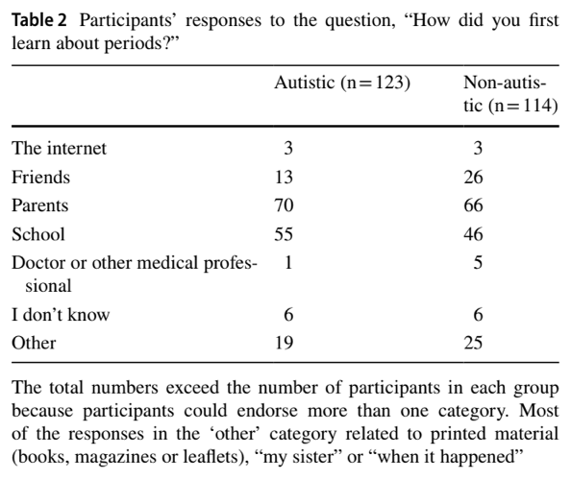
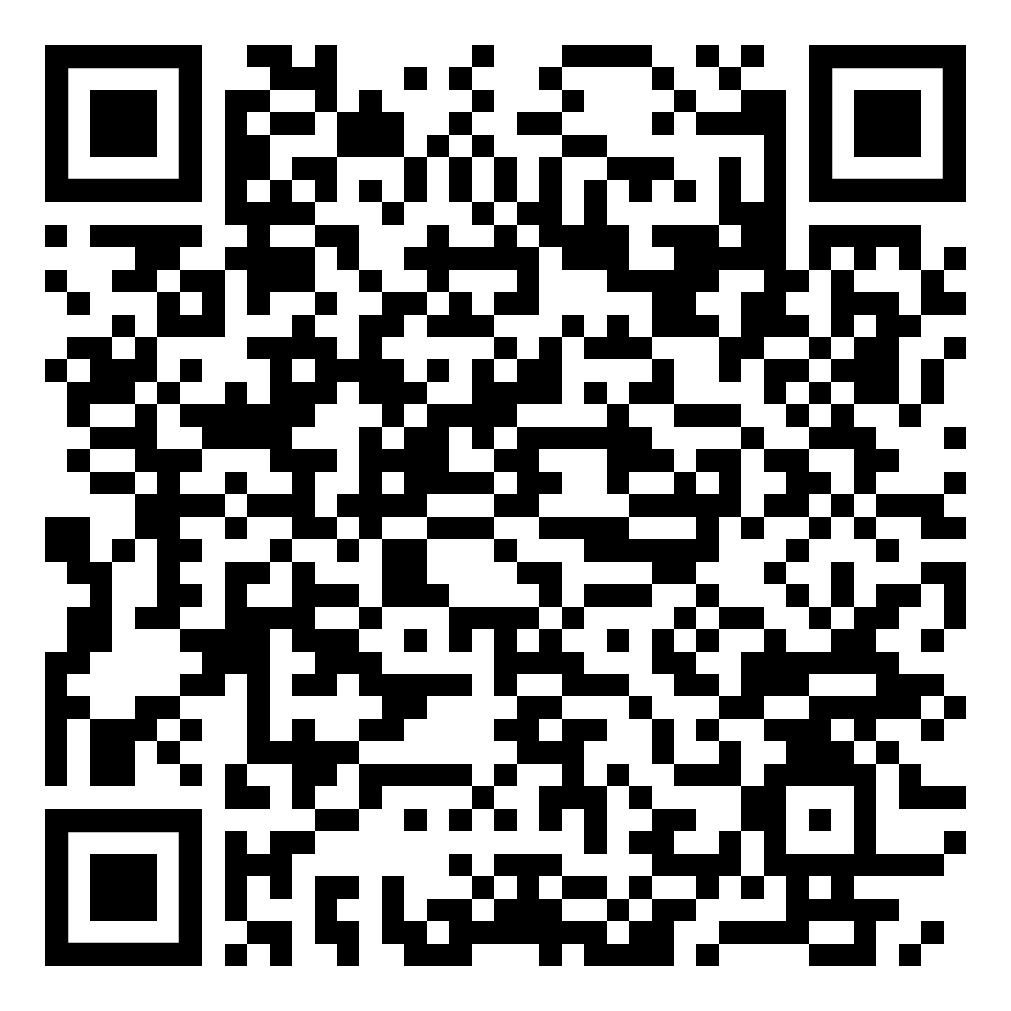
Education
By age 8:
Following guidelines for public v. private
Participating in hygiene routines
Respecting others’ privacy
Understanding rules for personal space and touching
SHEIDD-approved curricula:
Sexuality for All Abilities
Friendships and Dating
Positive Prevention PLUS
Consistent and precise use of language
Anatomy
Pubertal terms
What are some common “code names” people give to periods?
PollEv.com/keelymcculla234

Slide 15
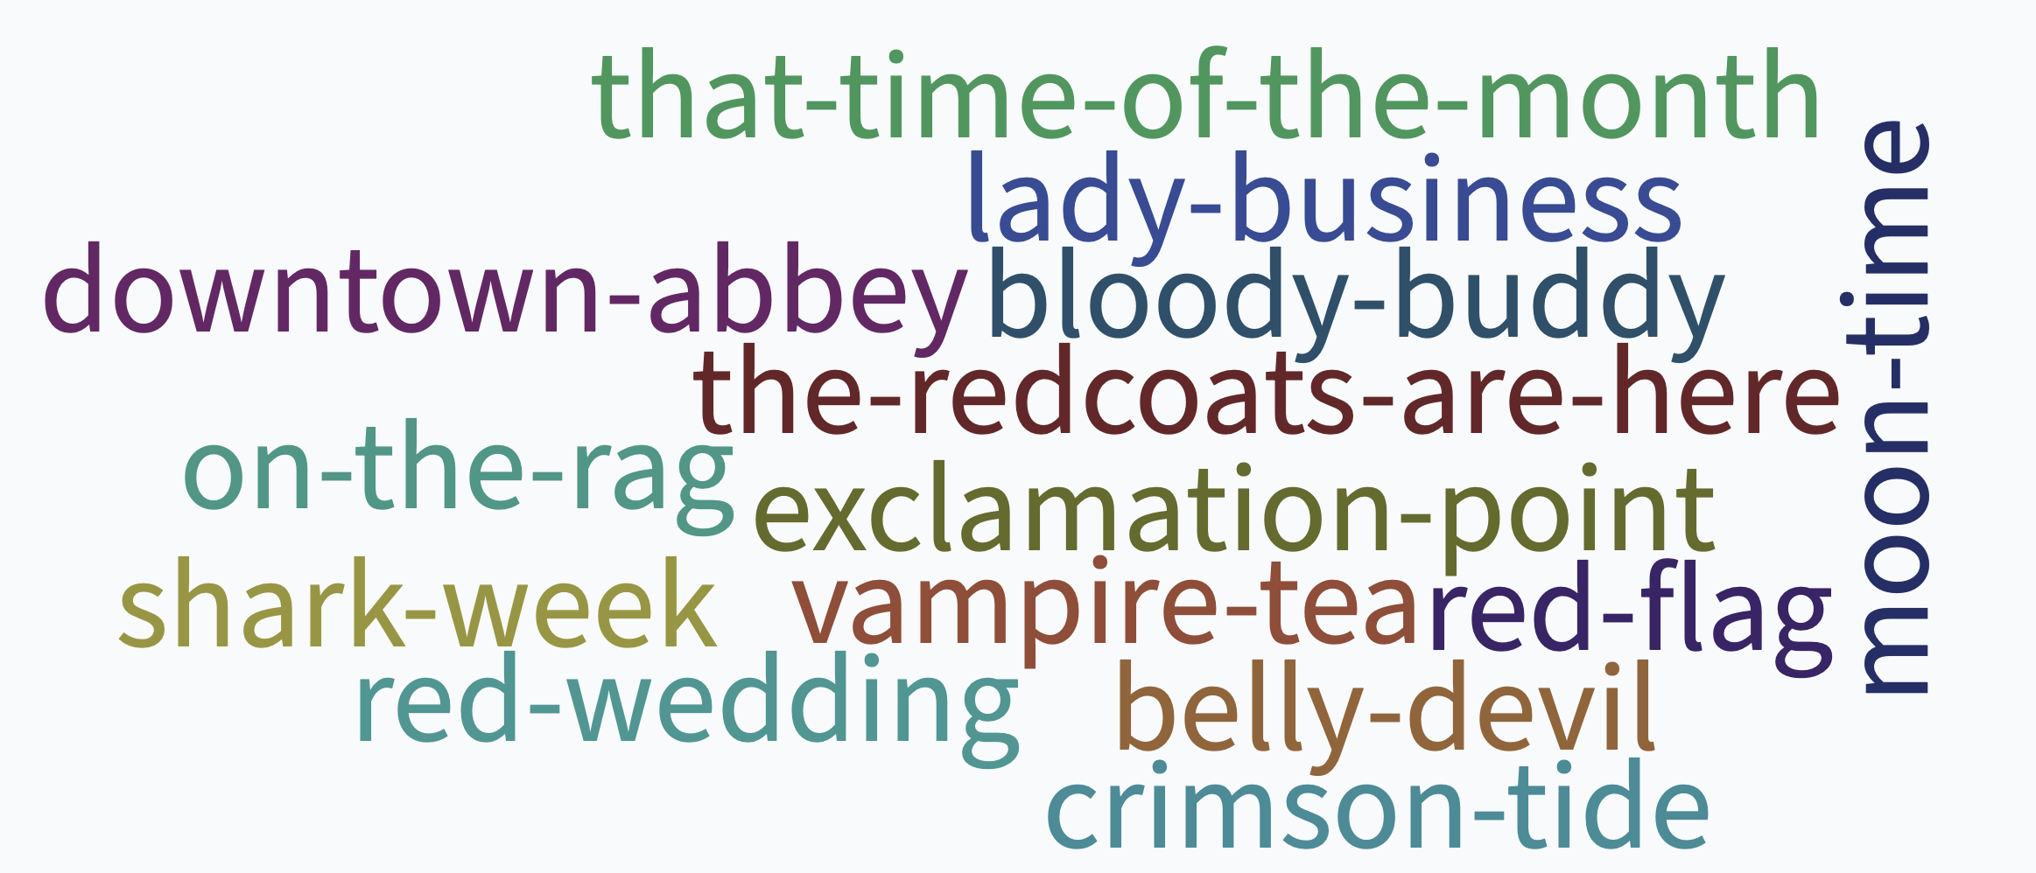

Slide 16
Menstrual Hygiene Management

Slide 17
Definition
“...[U]sing a clean menstrual management material to absorb or collect blood that can be changed in privacy as often as necessary for the duration of the menstruation period...[U]nderstanding the basic facts linked to the menstrual cycle and how to manage it with dignity and without discomfort or fear.”
(UNICEF, 2019)

Slide 18
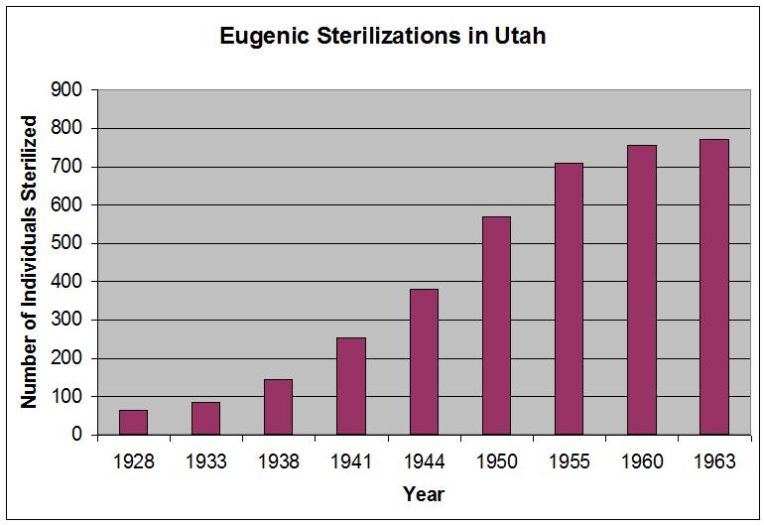
History of MHM
The Eugenics Movement
Eugenes means “well born”
Led to most states legalizing sterilization of the “undesirable”
60,000 people involuntarily sterilized
1942, Supreme Court ruled that reproductive freedom was a fundamental right for ALL
1970s, federal funding for sterilization programs was terminated
Other hold-ups:
Cultural factors- “Taboo”
Persons with disabilities weren’t considered “sexual beings”

Slide 19
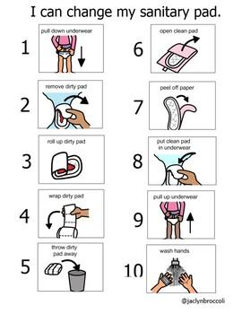
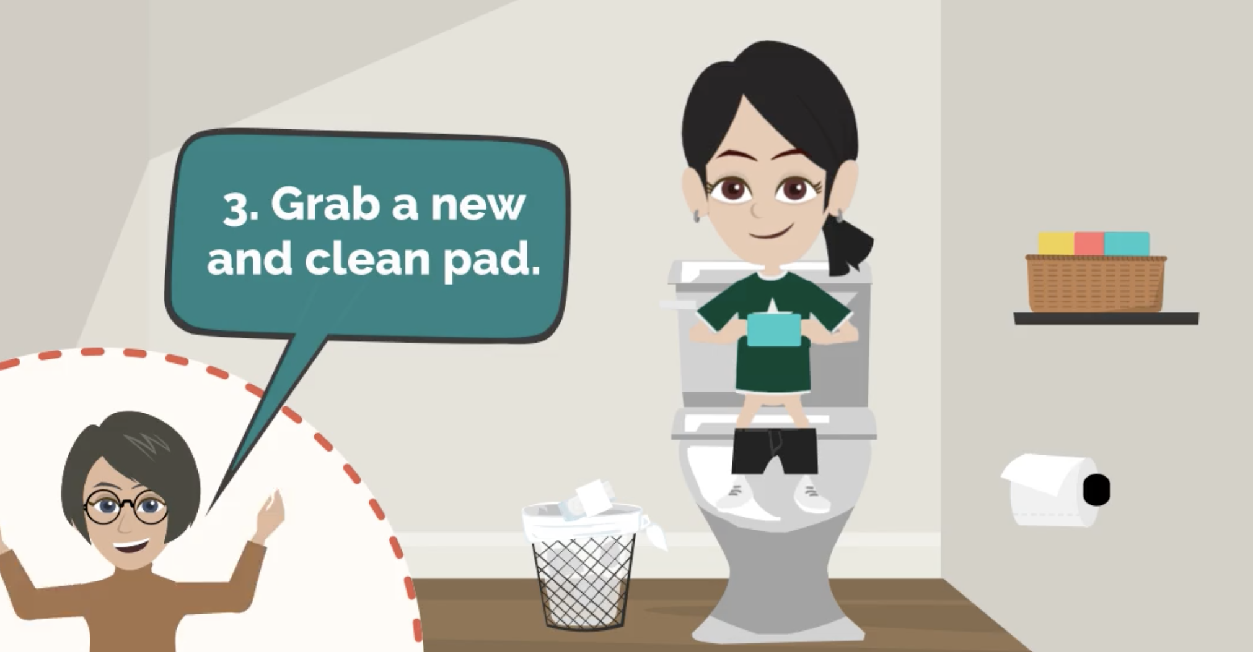
Increasing Autonomy
VISUAL SUPPORTS- Picture
VISUAL SUPPORTS- Video
Notes:
Teaser!

Slide 20
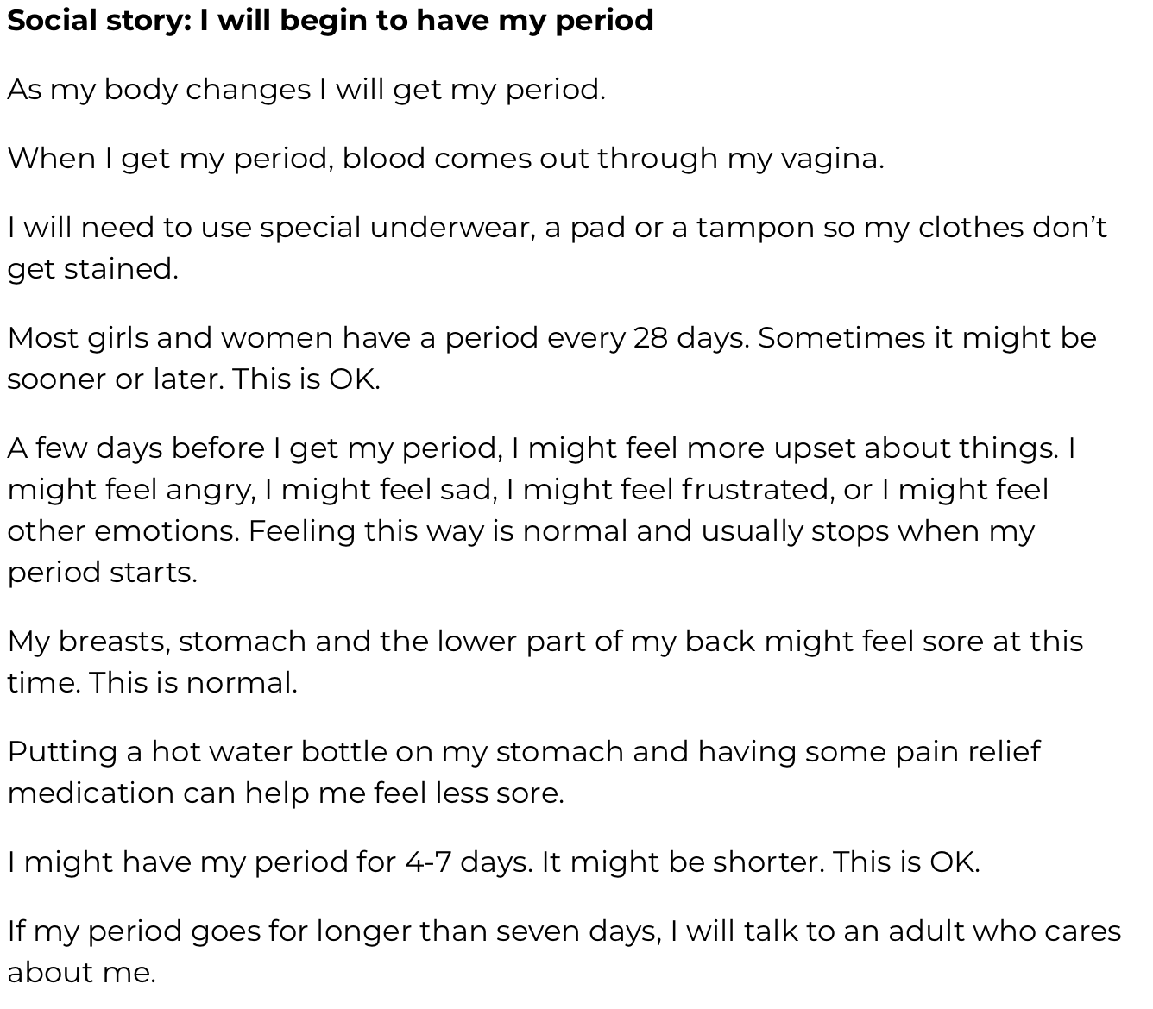
Increasing Autonomy
SOCIAL STORIES
Notes:
Teaser!

Slide 21
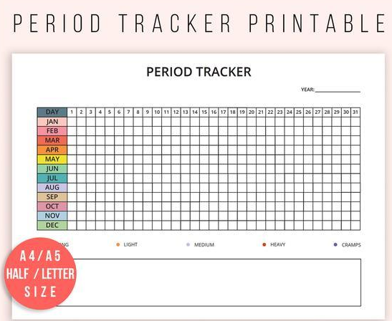
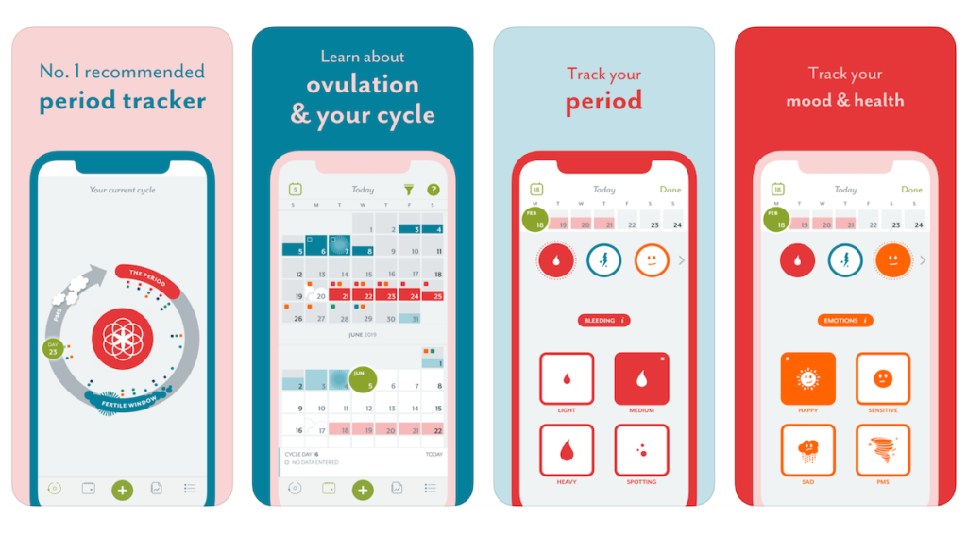
Increasing Autonomy
MENSTRUAL CALENDAR
Clue Period and Cycle Tracker
Notes:
Teaser!

Slide 22
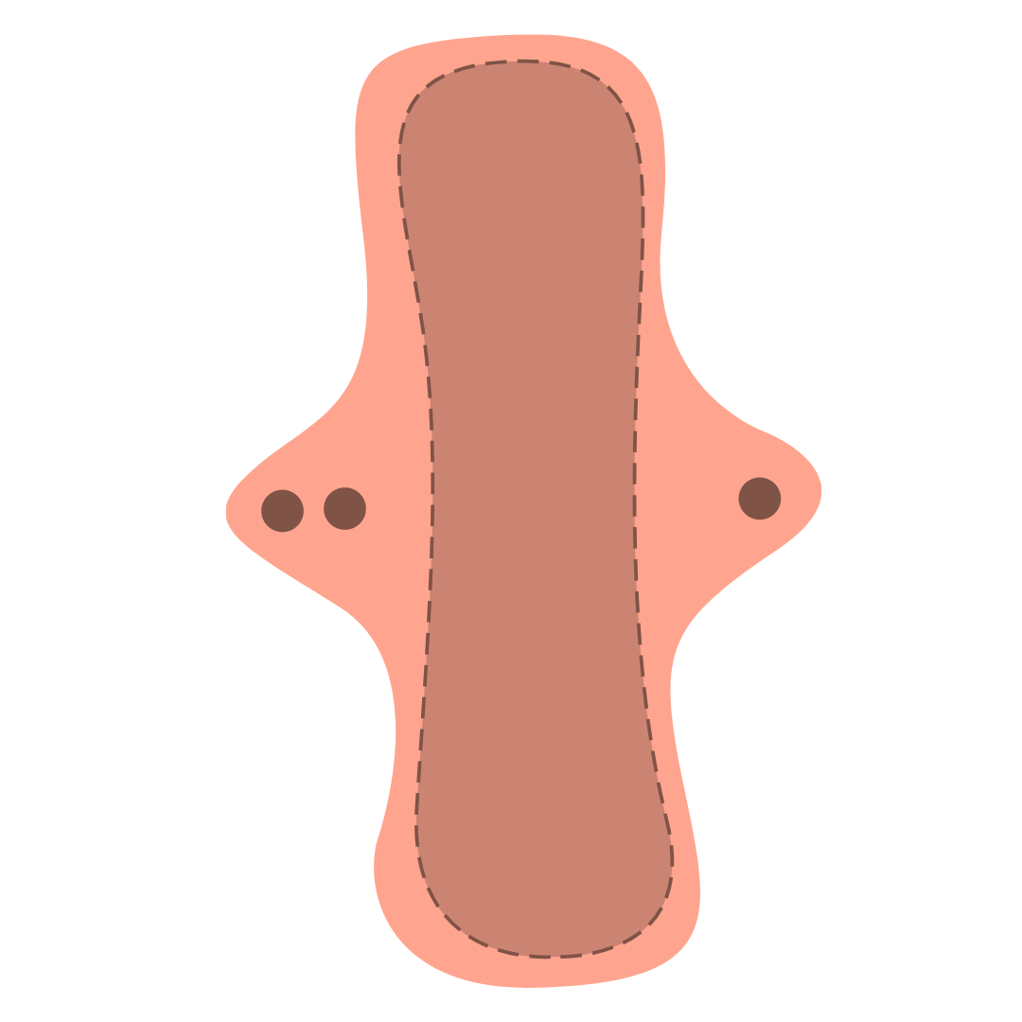
Increasing Comfort
EXPOSURE!!
Amaze Videos

Slide 23
Resources

Slide 24
To Name A Few...
Books
The Autism Friendly Guide to Periods by Robyn Steward
Taking Care of Myself: A Hygiene, Puberty and Personal Curriculum for Young People with Autism by Mary Wrobel
Educational Websites
Sex Positive Families
Amaze Videos
ASD Sex Ed
National Autistic Society
The Autism Community in Action
Podcasts
LOMAH (Land of Milk and Honey)
Sex Ed. for Self-Advocates
The Sue Larkey Podcast

Slide 25
Questions?

Slide 26
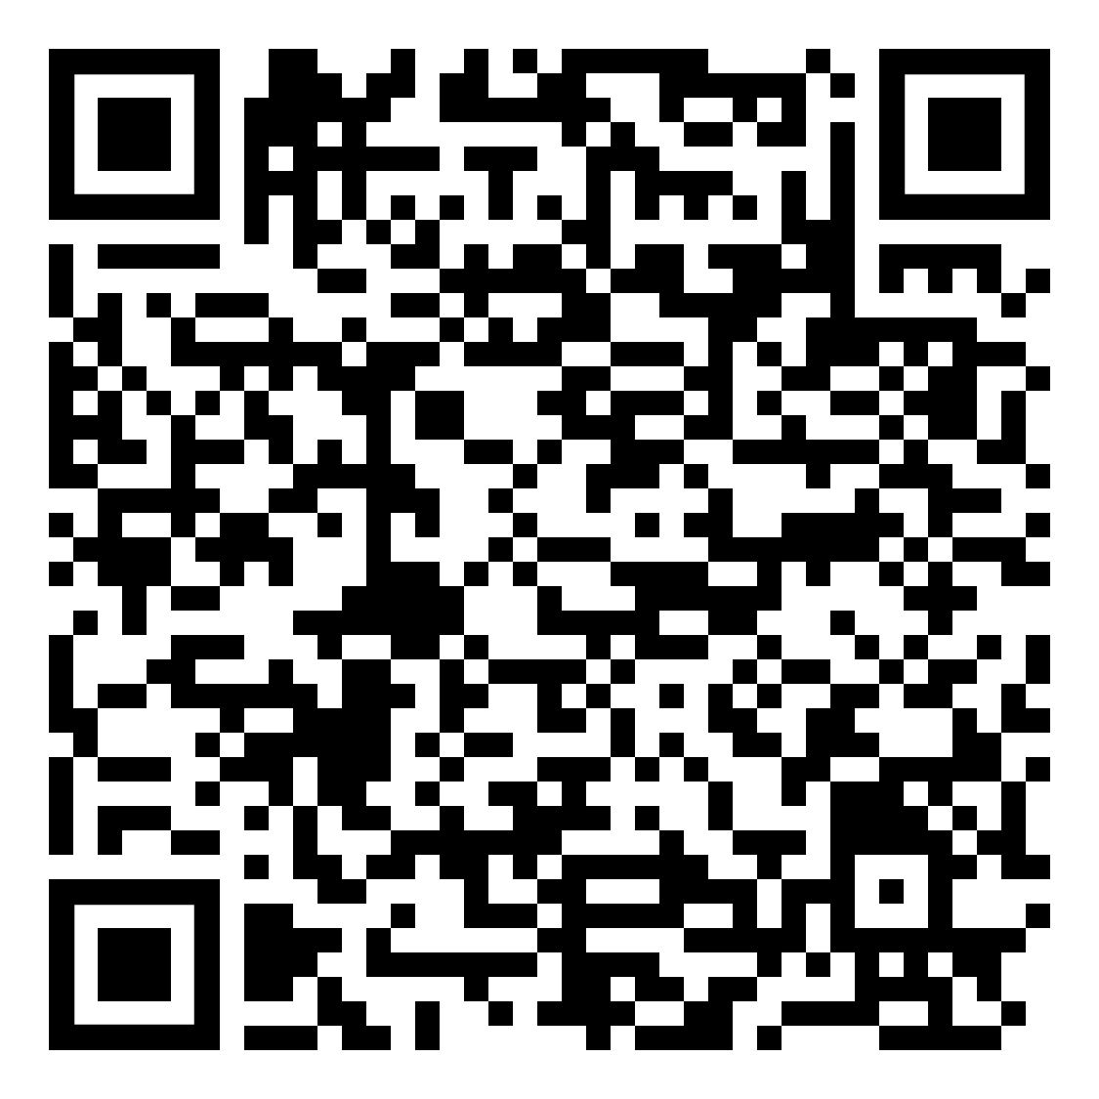
What is one thing you learned about today that has really stuck with you?
PollEv.com/keelymcculla234

Slide 27
Contact Information:
Email Address
Keely.Lundy@utah.edu

Slide 28
References
Inclusive Language
Bell, J. (2020, July 16). Talking about periods beyond gender. Retrieved March 01, 2021, from https://helloclue.com/articles/cycle-a-z/talking-about-periods-beyond-gender.
Dattaro, L. (2020, September 14). Largest study to date confirms overlap between autism and gender diversity. Retrieved March 16, 2021, from https://www.spectrumnews.org/news/largest-study-to-date-confirms-overlap-between-autism-and-gender-diversity/.
Dattaro, L. (2020, September 18). Gender and sexuality in autism, explained. Retrieved March 16, 2021, from https://www.spectrumnews.org/news/gender-and-sexuality-in-autism-explained./
Rydstrom, K. (2020). Degendering menstruation: Making trans menstruators matter. In C. Bobel et al., (Eds.). The Palgrave Handbook of Critical Menstruation Studies (pp. 945-959).
Unger, C.A. (2015). Care of the transgender patient: A survey of gynecologists’ current knowledge and practice. Journal of Women’s Health, 24(2), 114-118.
Via, E. (2019). Menstruating and doing masc: Trans experiences of menstruation (Doctoral dissertation). New College of Florida.
Warrier, V. Greenberg, D.M., Weir, E., Buckingham, C., Smith, P., Lai, M.C.,...& Baron-Cohen, S. (2020). Elevated rates of autism, other neurodevelopmental and psychiatrics diagnoses, and autistic traits in transgender and gender-diverse individuals. Nature communications, 11(1), 1-2.

Slide 29
References
Puberty and ASD
American Psychiatric Association. (2013). Diagnostic and statistical manual of mental disorder (5th ed.). https://doi.org/10.1176/appi.books.9780890425596.
Anderson, D.K., Maye, M.P., & Lord, C. (2011). Changes in maladaptive behaviors from midchildhood to young adulthood in autism spectrum disorder. American Journal on Intellectual and Developmental Disabilities, 116(5), 381-397.
Bitsika, V., & Sharpley, C.F. (2018). The effects of menarche upon the sensory features of girls with autism spectrum disorder. Journal of DEvelopmental and Physical Disabilities, 30(6), 755-769.
Burke, L.M., Kalpakjian, C.Z., Smith, Y.R., & Quint, E.H. (2010). Gynecological issues of adolescents with Down syndrome, autism, and cerebral palsy. Journal of Pediatric and Adolescent Gynecology, 23(1), 11-15.
Corbett, B.A., Vandekar, S., Muscatello, R.A., & Tanguturi, Y. (2020). Pubertal timing during early adolescence: Advanced pubertal onset in females with autism spectrum disorder. Autism Research, 13(12), 2202-2215.
Nichols, S., Moravcik, G.M., & Tetenbaum, S.P. (2009). Girls growing up on the autism spectrum. Jessica Kinglsey Publishers.
SHEIDD Community Advisory Group. (2020). SHEIDD review of sexual health education curricula designed for people with disabilities. https://www.ohsu.edu/sites/default/files/2019-08/Review%20of%20Sexual%20Health%20Education%20Curricula%20Designed%20for%20People%20with%20Disabilities%208.2019.pdf.
Steward, R., Crane, L., Roy, E.M., Remington A., & Pellicano, E. (2020). “Life is much more difficult to manage during periods”: Autistic experiences of menstruation. The Palgrave Handbook of Critical Menstruation Studies, 751.

Slide 30
References
Menstrual Hygiene Management
Autism Speaks. (2011). Visual supports and autism. https://www.autismspeaks.org/sites/default/files/2018-08/Visual%20Supports%20Tool%20Kit.pd.f
Committee on Bioethics (1999, August). Sterilization of Minors With Developmental Disabilities. American Academy of Pediatrics. (104), 2.
Involuntary Sterilization of Disabled Americans: A Historical Review. (2018, November 6). ABC Law Centers.https://www.abclawcenters.com/blog/2018/11/06/involuntary-sterilization-of-disabled-americans-an-historical-overview/
Kaelber, Lutz. (2012). Eugenics: Compulsory Sterilization in 50 American States. University of Vermont. http://www.uvm.edu/~lkaelber/eugenics/
Klett, L.S., & Turan, Y. (2021). Generalized effects of social stories with task analysis for teaching menstrual care to three young girls with autism. Sexuality and Disability, 30(3), 319-336.
Raine, S.P. (2012, February). Federal Sterilization Policy: Unintended Consequences. AMA Journal of Ethics. https://journalofethics.ama-assn.org/article/federal-sterilization-policy-unintended-consequences/2012-02
Sterilization of Women and Girls with Disabilities. (2011. November 10). Human Rights Watch. https://www.hrw.org/news/2011/11/10/sterilization-women-and-girls-disabilities#
The Australian Parenting Website. (2020, July 12). Autistic girls: Periods. Raising Children. https://raisingchildren.net.au/autism/development/physical-development/periods-and-autism
UNICEF. (2019). Guide to menstrual hygiene materials. https://www.unicef.org/wash/files/UNICEF-Guide-menstrual-hygiene-materials-2019.pdf
Volokh, E. (2014, April 18). Sterilization of the “intellectually disabled.” The Washington Post. https://www.washingtonpost.com/news/volokh-conspiracy/wp/2014/04/18/sterilization-of-the-intellectually-disabled/

