Slide 1

Positive Behavior Interventions and Supports in the Home
Morgan Hutchinson

Slide 2
Objectives
Understand the difference between reactive and proactive parenting
Learn what PBIS is and why it is useful in the home
Implement PBIS practices in your home to help reduce problem behavior
Learn strategies for correcting problem behavior and implementing negative consequences

Slide 3
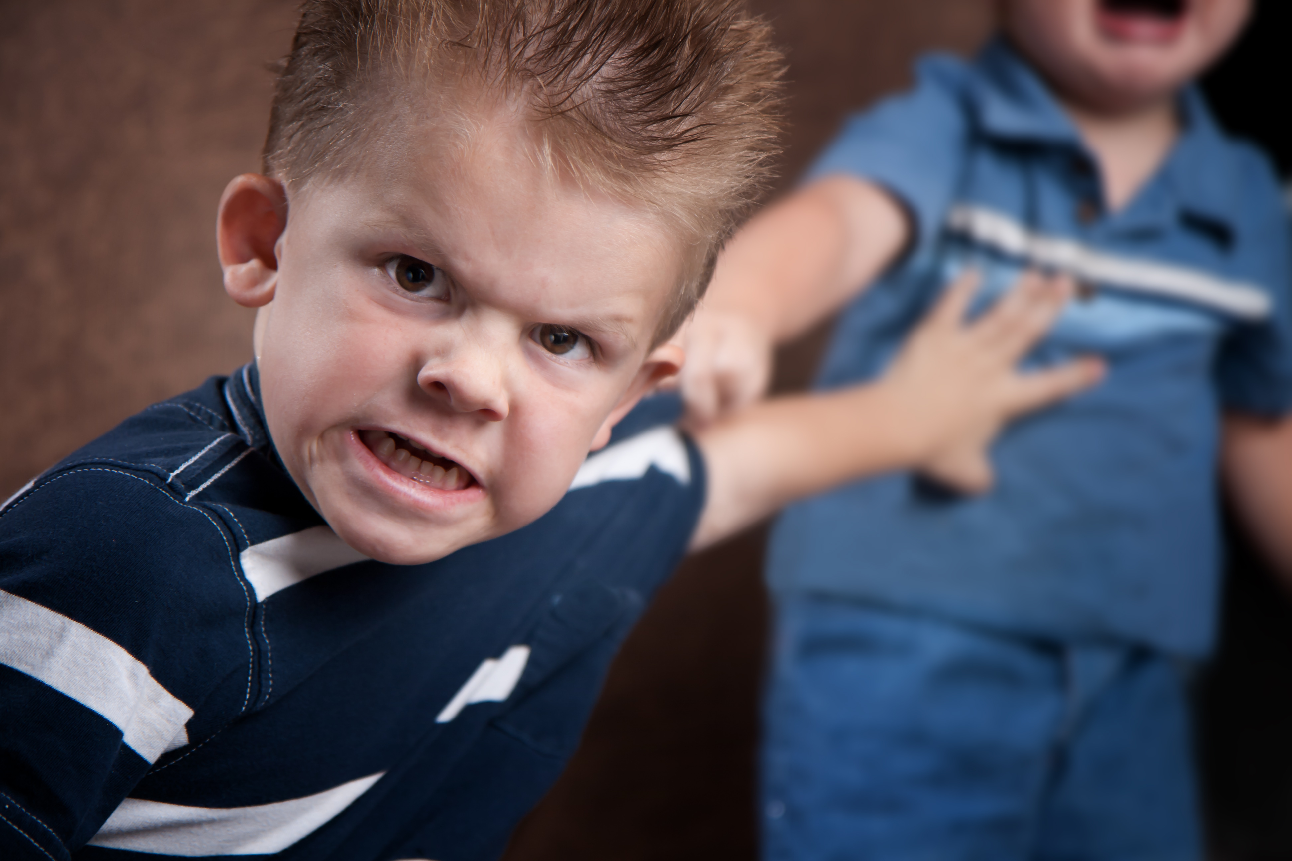

Slide 4


Slide 5


Slide 6


Slide 7
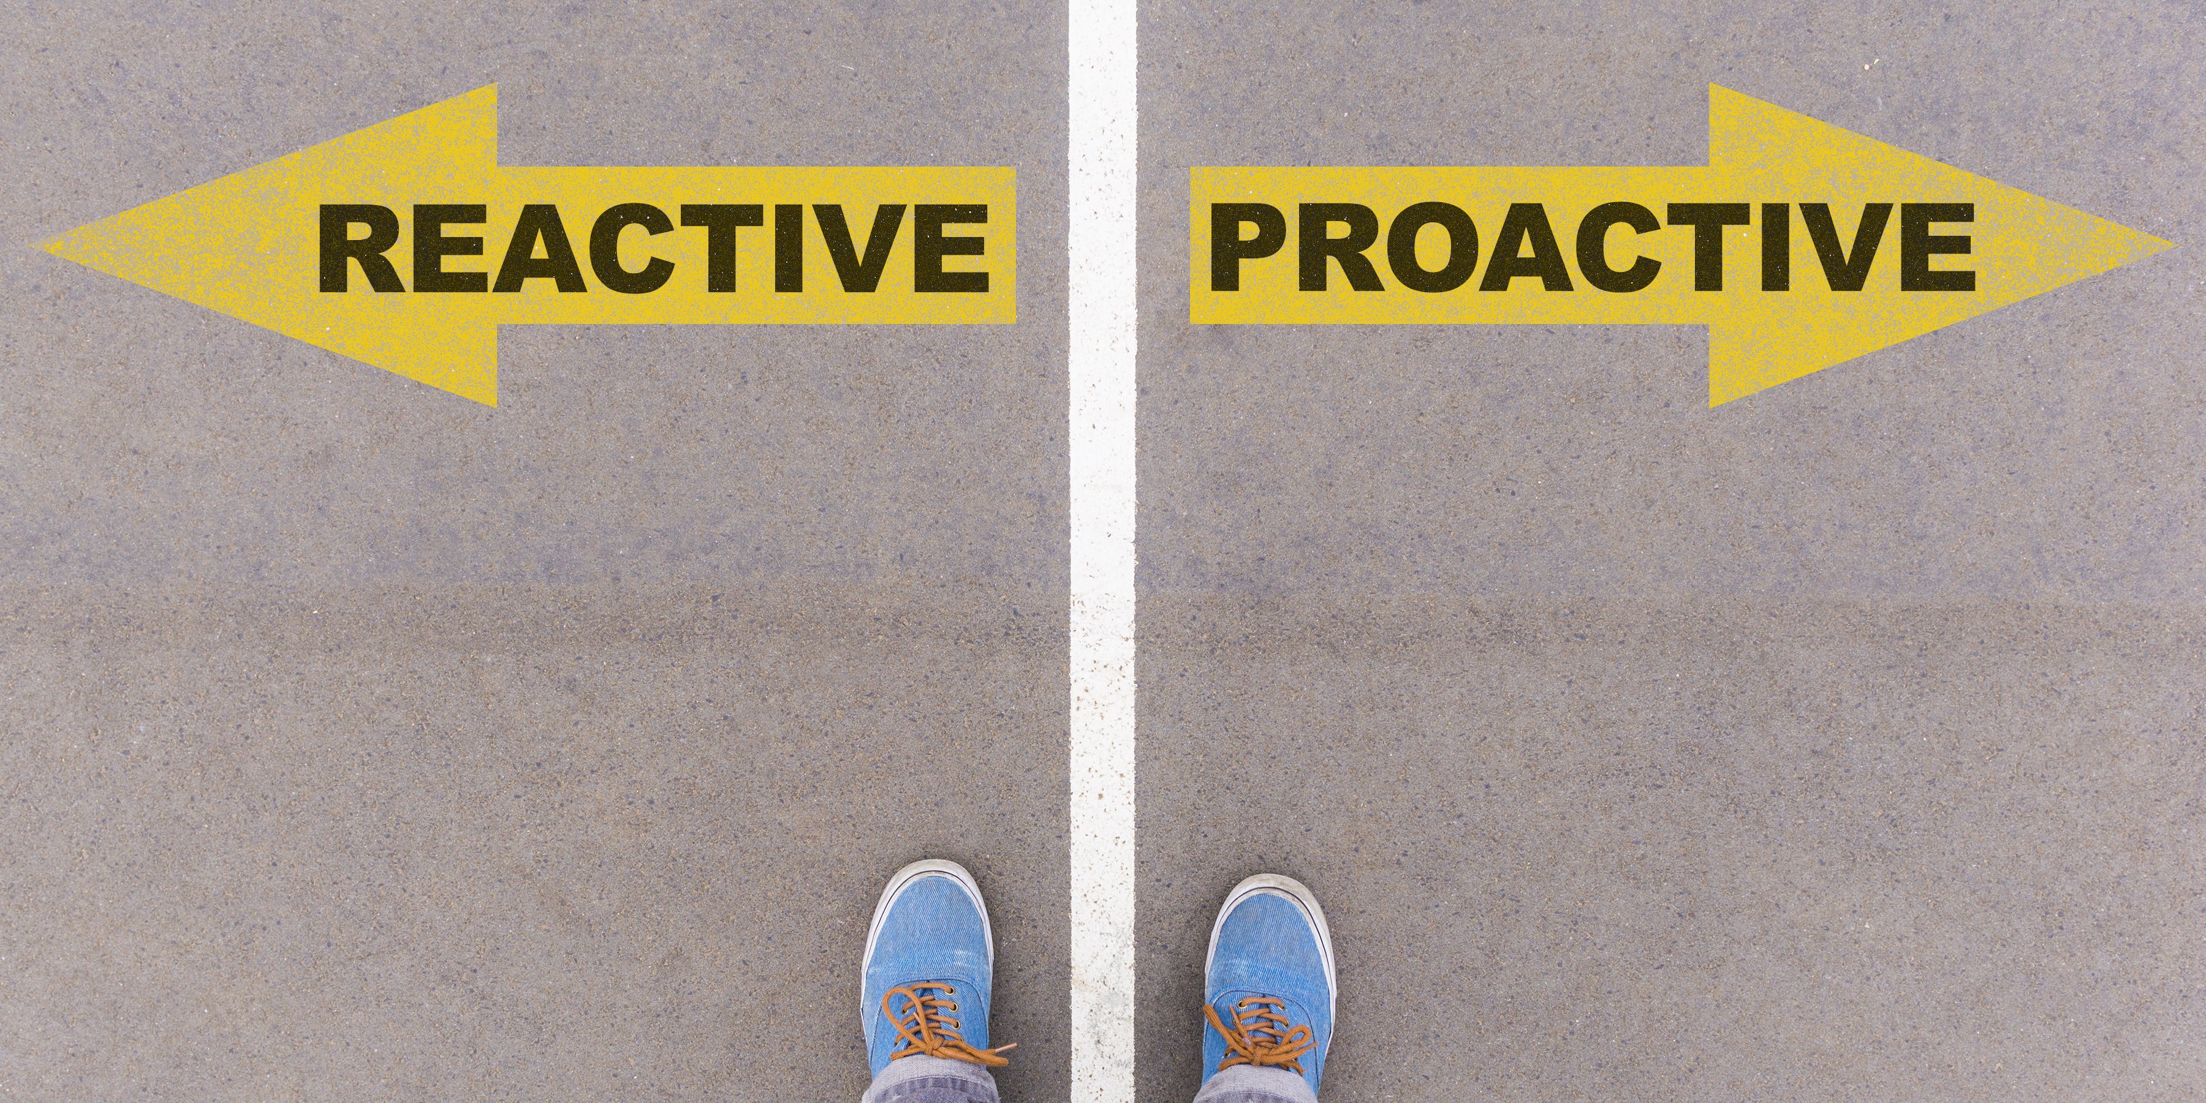
Creating or controlling a situation by causing something to happen rather than waiting to respond to it after it has happened
Tending to be responsive or react to a stimulus

Slide 8
Reactive Parenting | Proactive Parenting
“You didn’t get your homework done, so you lost tablet time” | “Five more minutes on your tablet and then you have to do homework”

Slide 9
Reactive
Proactive

Slide 10
What is PBIS?

Slide 11
Positive Behavior Interventions and Supports
Proactive
Behavior Management System
Prevent/Reduce Problem Behavior

Slide 12
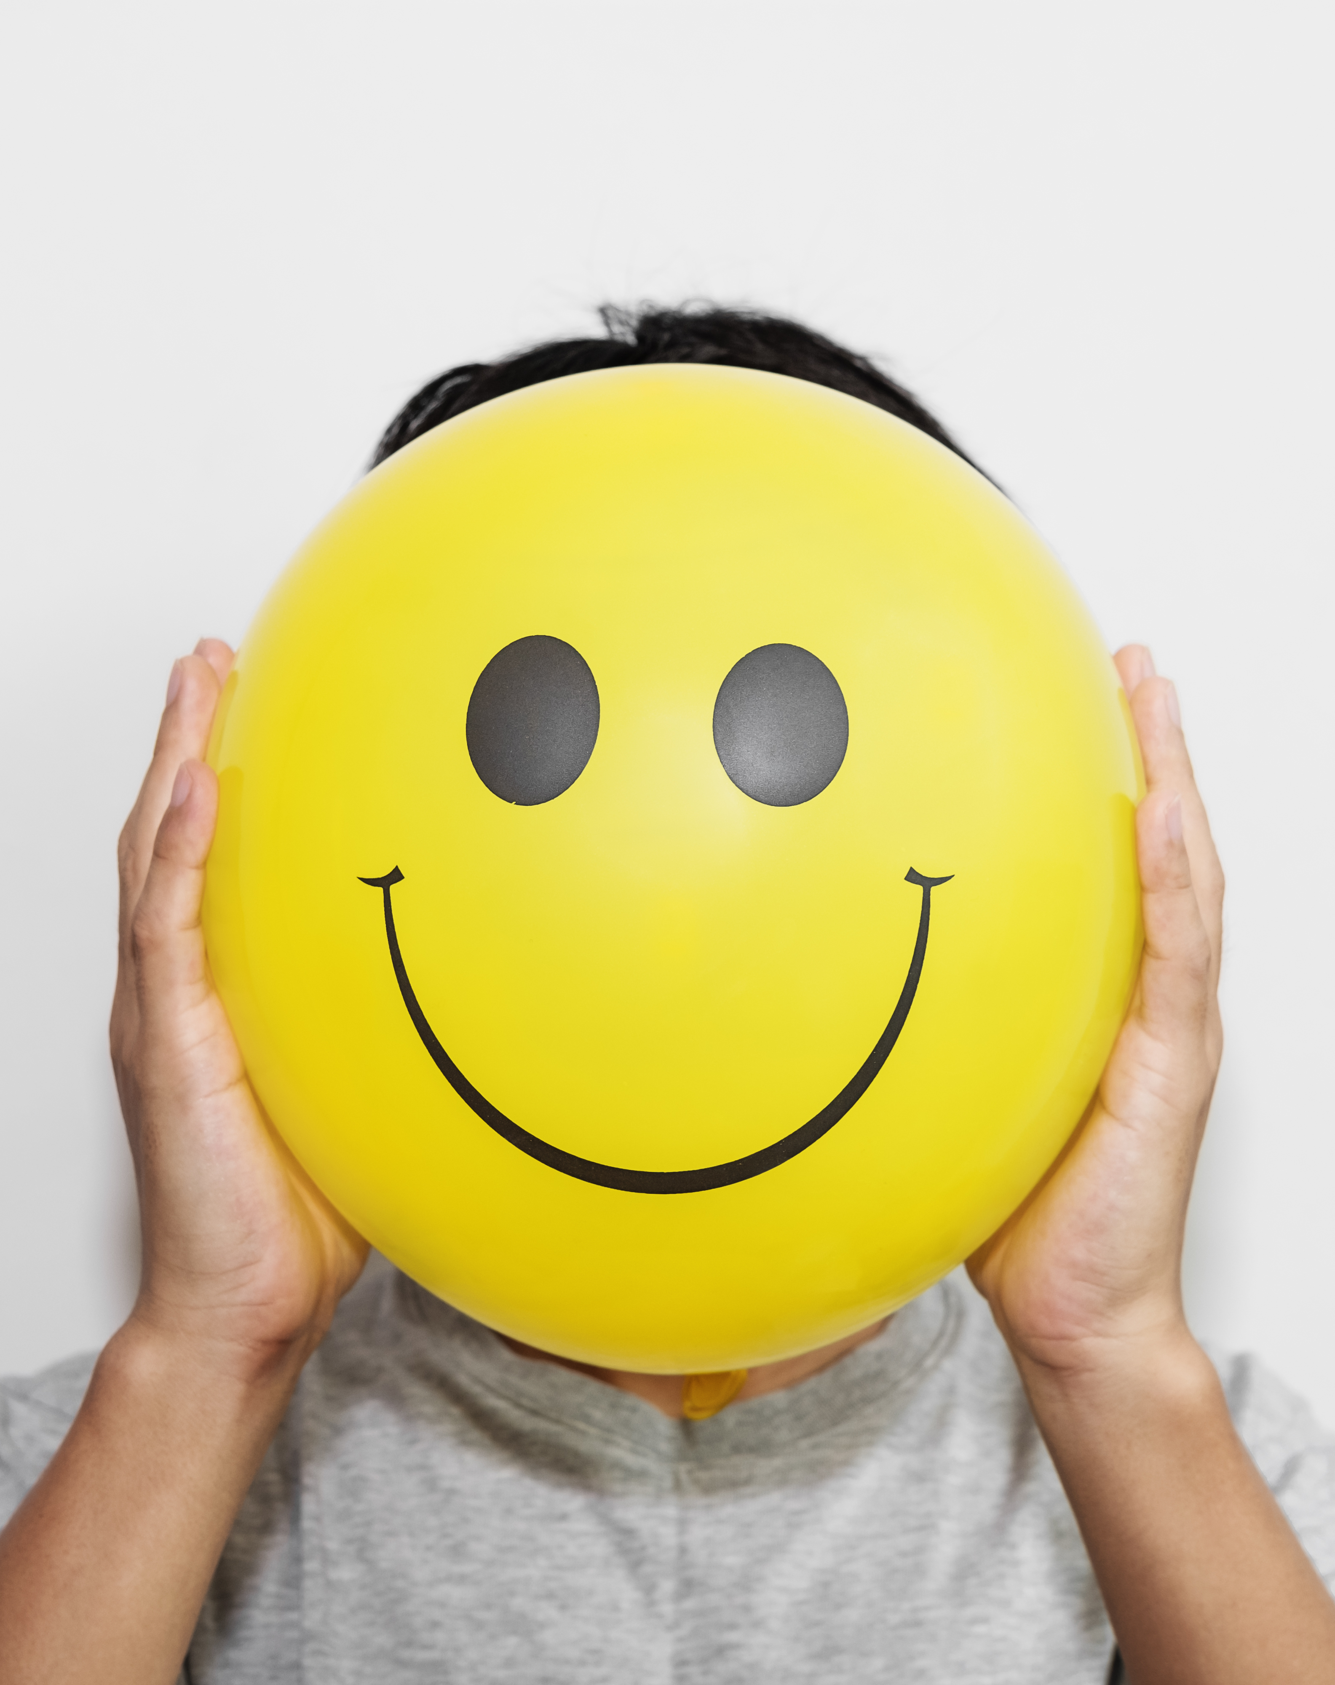
Positive
Avoid harsh punishments
Instructional Emphasis
Environmental adjustments

Slide 13
Behavior
Three Principals of PBIS:
  Behavior is learned
  Behavior is lawful
  Behavior can be changed

Slide 14
Interventions and Supports
Hands on strategies
Evidence based

Slide 15

PBIS in the Schools

Slide 16
PBIS in Schools
Improve Student outcomes
Reduce problem behaviors
Improve teacher outcomes

Slide 17
Three Tiered System
Tier 3
Tier 2
Tier 1
ll
Notes:
.

Slide 18
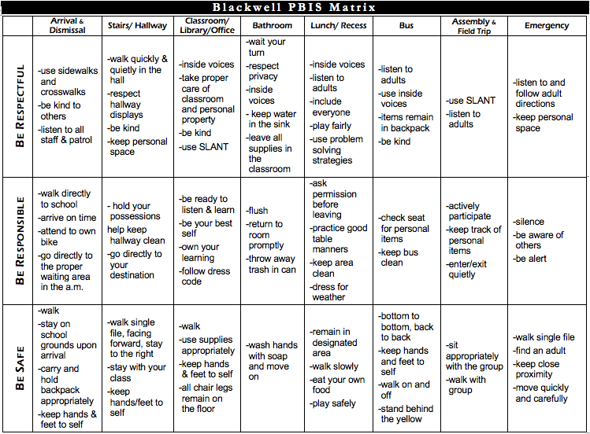

Slide 19

PBIS in the Home

Slide 20


Slide 21
Structure
Expectations
Reinforcement
Correction

Slide 22
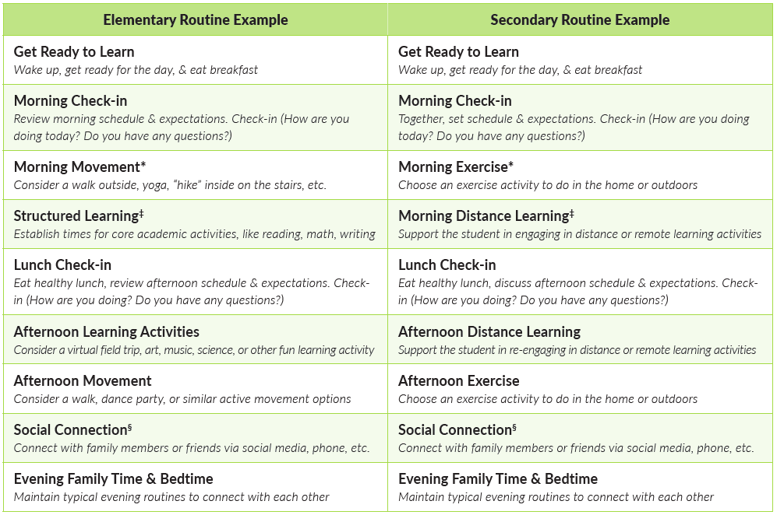

Structure

Slide 23
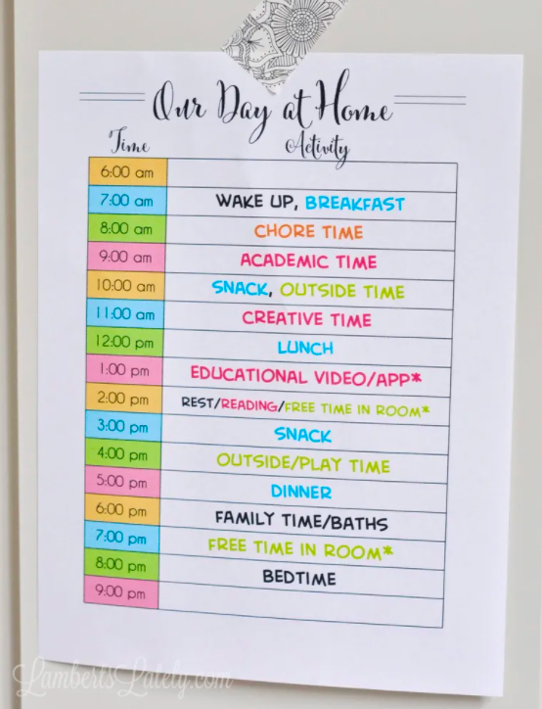
https://lambertslately.com/how-to-schedule-your-day.html
Notes:
https://lambertslately.com/how-to-schedule-your-day.html

Slide 24
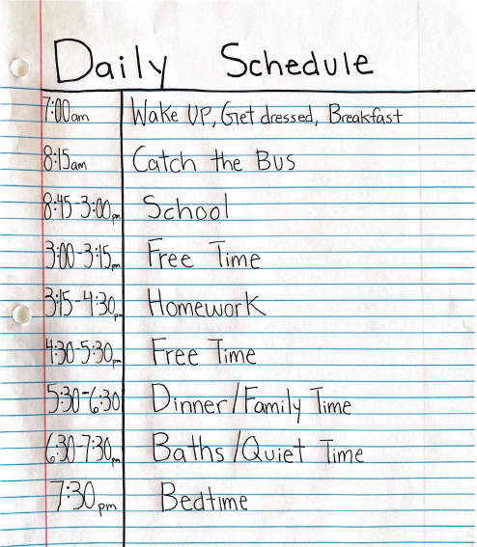
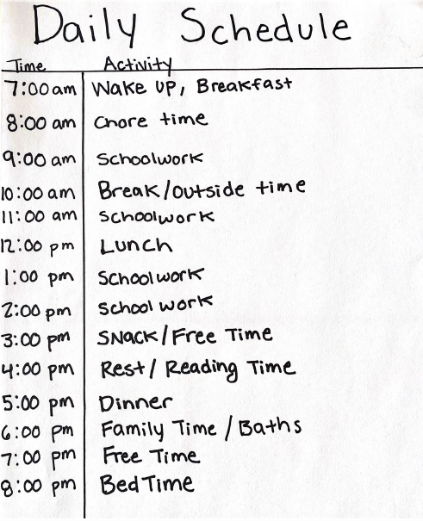

Slide 25
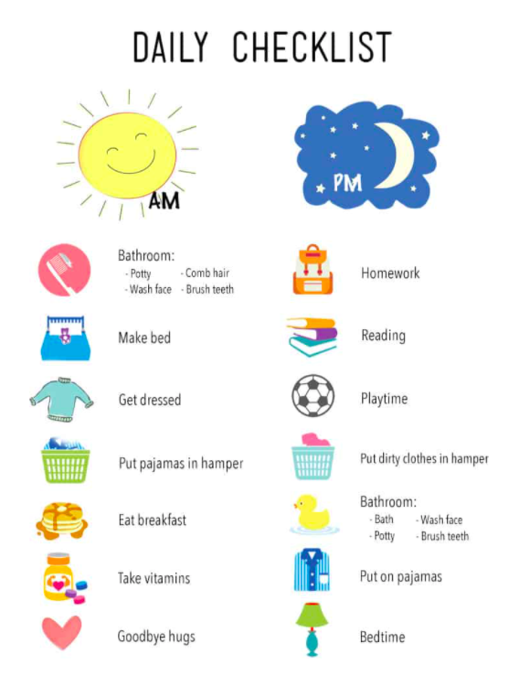
https://www.cupcakediariesblog.com/printable-daily-checklist-for-kids/

Slide 26
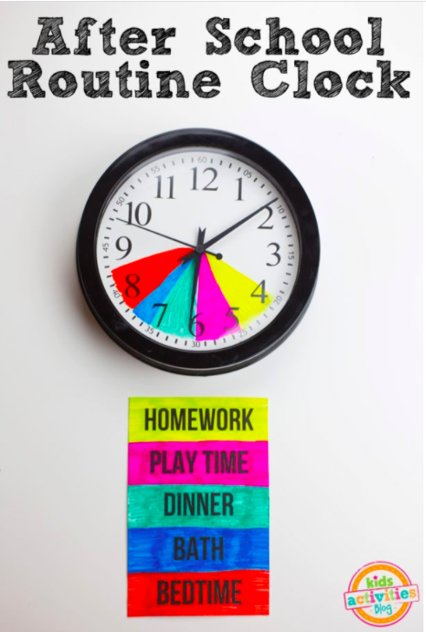
https://kidsactivitiesblog.com/91715/school-routine-clock
Notes:
https://kidsactivitiesblog.com/91715/school-routine-clock

Slide 27
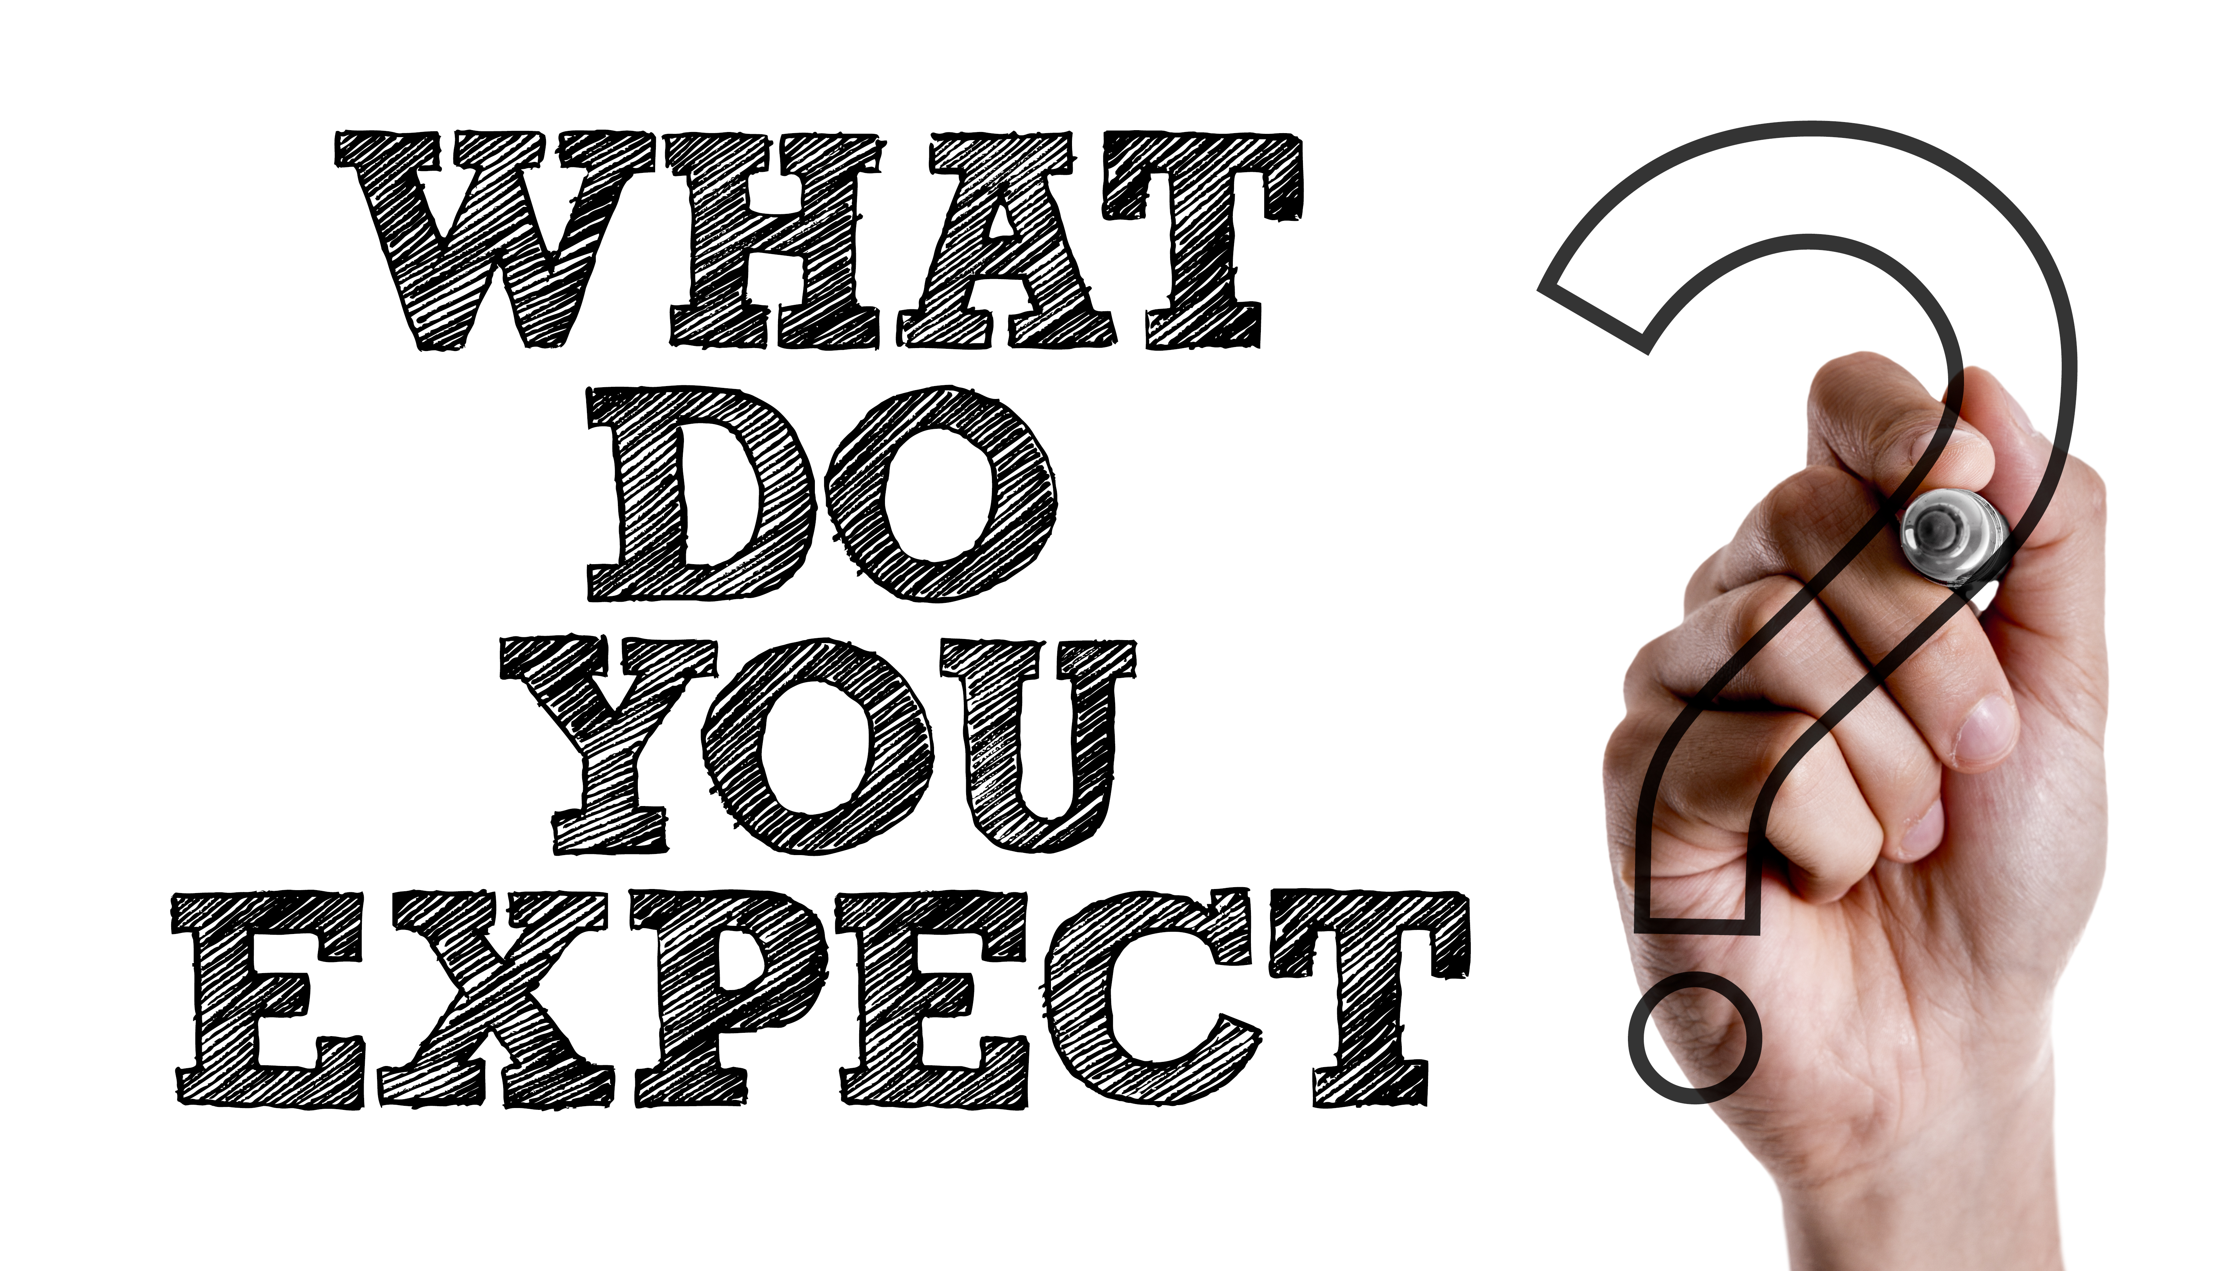
Expectations
“If a child doesn’t know how to read, we teach”
“If a child doesn't know how to swim, we teach”
“If a child doesn’t know how to multiply, we teach”
“If a child doesn’t know how to drive, we teach”
“If a child doesn’t know how to behave, we….. Teach?.....punish?”
“Why can’t we finish the last sentence as automatically as we do the others?”
(Herner, 1998)
Notes:
.Reference Tom Herner 1998 (NASDE President)

Slide 28
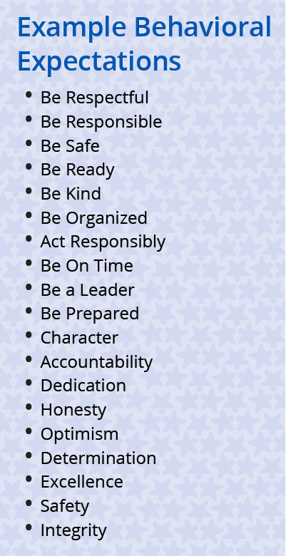
Establishing Expectations
Select 3-5 behavioral expectations
  Use child’s schoolwide expectations if possible
Expectations stated positively
  Non-example “No disrespect, no fighting, no rough housing”
  Example “Be respectful, Be kind, Be safe”
Vanderbilt. Edu
Notes:
https://vkc.mc.vanderbilt.edu/assets/files/resources/tbsp-behaviorexpectationstips.pdf

Slide 29
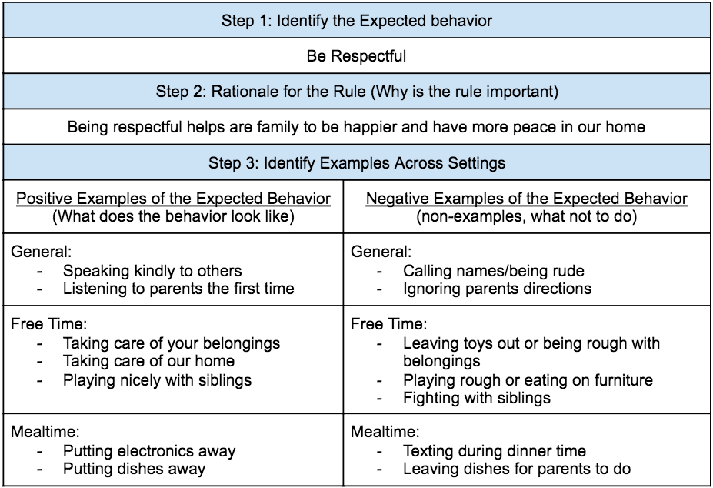

Slide 30
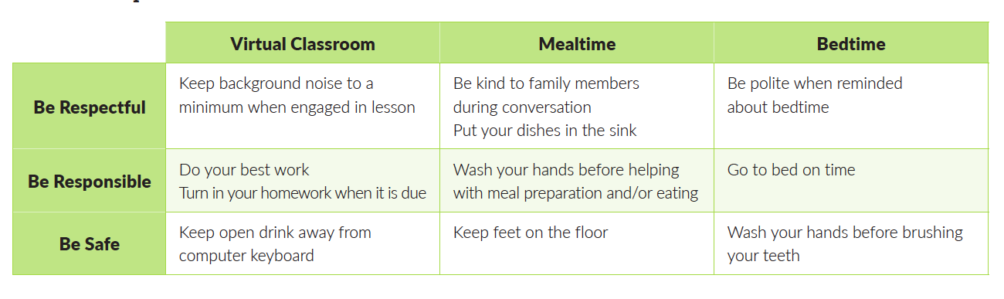
Expectations Clearly Defined Across Settings
Notes:
.

Slide 31
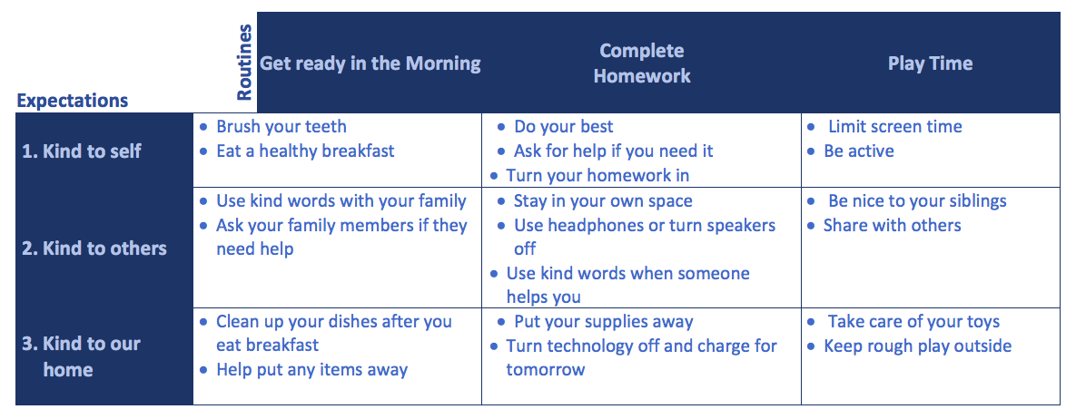
https://www.pbis.org/resource/family-plan-for-positive-behavior-at-home
Notes:
https://www.pbis.org/resource/family-plan-for-positive-behavior-at-home

Slide 32
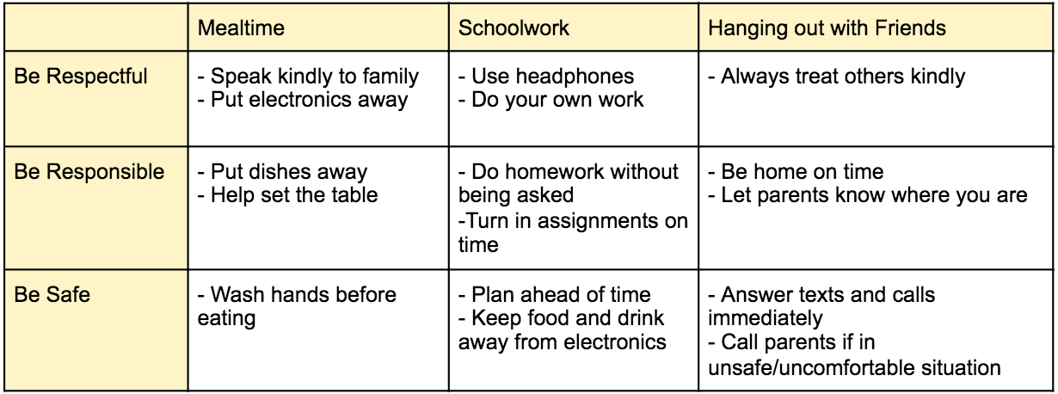
Expectations for Pre-Teens/Teens

Slide 33

Teaching Expectations
Discuss:
  Introduce the expectation
  Explain the reason
  Give examples, Non Examples
  Review what the expectation looks like across different settings
Teach
  Show
  Practice
  Watch
Remind

Slide 35
Reinforcement
Anything that increases or maintains behavior

Slide 36
Behavior Specific Praise
Tie it back to your expectations
Safe | Respectful | Responsible | Kind to yourself | Kind to our home
Thanks for being safe by not running in the house. | I love how you were respectful by listening to directions the first time. | Good job being responsible by starting your homework right away. | Fantastic job being kind to yourself by brushing your teeth. | Thanks for being kind to our home by putting your toys away.

Slide 37
Types of Reinforcement
Attention (praise, play time with caregiver)
Tangibles (treats, electronics, toys)
Privileges (free time, later bedtime)
Activities (games, art and crafts)
Use child’s preferences and choices

Slide 38
Behavior Correction
Quickly Correct
the Behavior
"That was not respectful”
Re-state the expectation
“My expectation is that you speak kindly to your sister”
Provide an opportunity for positive interaction
“Let’s try again. How can you speak respectfully to your sister?"
Provide positive feedback
“That was a nice thing to say. Great job being respectful”

Slide 39
Consequences
Be Safe Be Respectful Be Responsible |  | Behavior Consequences | Example
 | 1 | Verbal Warning/Behavior Correction | “That was not respectful. My expectation is you speak kindly to your sister. Let’s try again”
 | 2 | Reteach | “That’s step two. Remember, being respectful helps our family be happier and have more peace in our home. How can you show respect in this situation?
 | 3 | Time out | “That’s the third time you haven’t been respectful. Step 3 is timeout for _____ minutes."
 | 4 | Loss of privileges for the day (screen time, play time, etc.) | “That’s step four for not showing respect. You lose tv/phone privileges for tonight.”
 | 5 | Grounded | “That’s step five. You’ve had many warnings and opportunities to show respect. Since you are still not showing respect, you are grounded for ______ days."

Slide 40
Behavior Consequence Tips
Calm, neutral tone of voice. Avoid arguing and lecturing.
Consistency
Consequences posted and visible
Tie consequence back to expectation
Reward desired behavior immediately
Time out length: one minute for every year old
Notes:
https://www.pbisworld.com/tier-1/clear-consistent-predictable-consequences/

Slide 41
After Behavior Consequences
5:1 positive to negative ratio
  Increase on task behavior
  Fewer disruptive behaviors
  Greater compliance with expectations

Slide 42
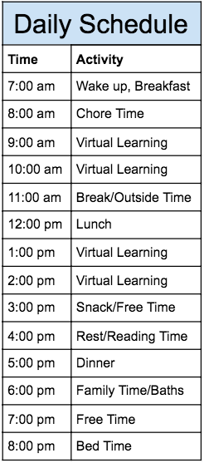
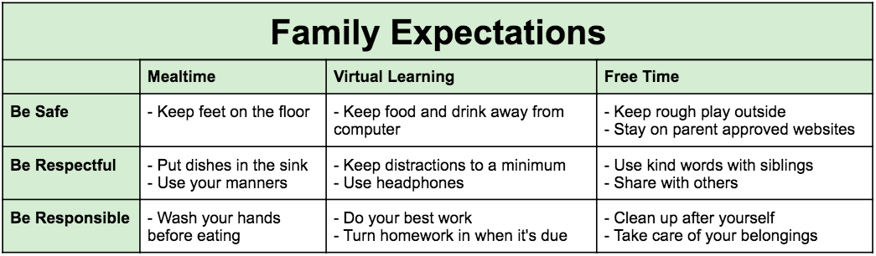
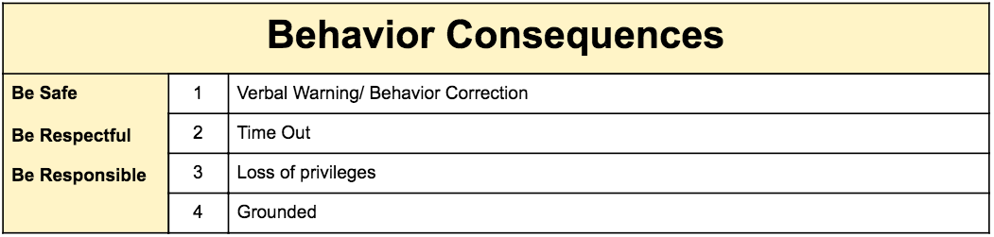

Slide 43
Review
PBIS is Proactive
Structure
Create a Schedule
Expectations
Discuss, Teach, Remind
Reinforcement
Behavior Specific Praise
Correction/Negative Consequences
Behavior correction
Consequence hierarchy

Slide 44

References
Arena, Michelle, Tabby, Becca, Hawkey, E., Mike, Elam, C. (2020, July 14). This After School Routine Clock will help you to stay on the schedule! Retrieved September 24, 2020, from https://kidsactivitiesblog.com/91715/school-routine-clock
Clear, Consistent, And Predictable Consequences. (n.d.). Retrieved September 24, 2020, from https://www.pbisworld.com/tier-1/clear-consistent-predictable-consequences/
Dunlap, G., Fox, Lise, Lee, Janice K, Strain, Phillip S, Vatland, Christopher, Joseph, Jaclyn D, & Turnbull, Ann. (2016). Prevent-Teach-Reinforce for Families : A Model of Individualized Positive Behavior Support for Home and Community.
Getting Started. (n.d.). Retrieved September 24, 2020, from https://www.pbis.org/pbis/getting-started
Leslie, Charity, Molly, Jessica, & Kelcie. (2020, April 16). How to Schedule Your At-Home Day During Quarantine. Retrieved September 24, 2020, from https://lambertslately.com/how-to-schedule-your-day.html
Printable Daily Checklist for Kids. (2019, August 01). Retrieved September 24, 2020, from https://www.cupcakediariesblog.com/printable-daily-checklist-for-kids/
Resource: Family Plan for Positive Behavior at Home. (2020, August 17). Retrieved September 11, 2020, from http://www.pbis.org/resource/family-plan-for-positive-behavior-at-home
Resource: Supporting Families with PBIS at Home. (2020, March 31). Retrieved September 24, 2020, from http://www.pbis.org/resource/supporting-families-with-pbis-at-home

Slide 45
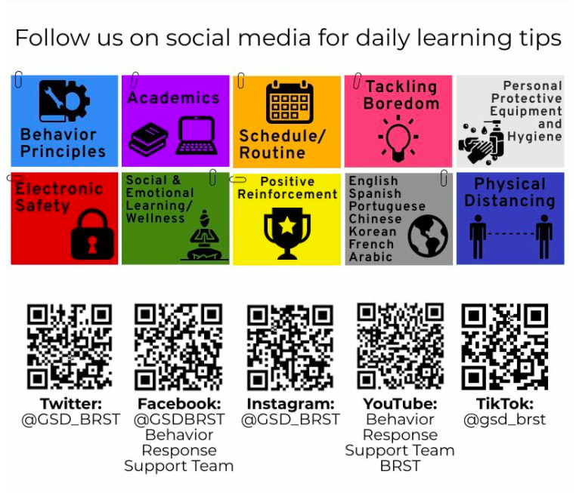
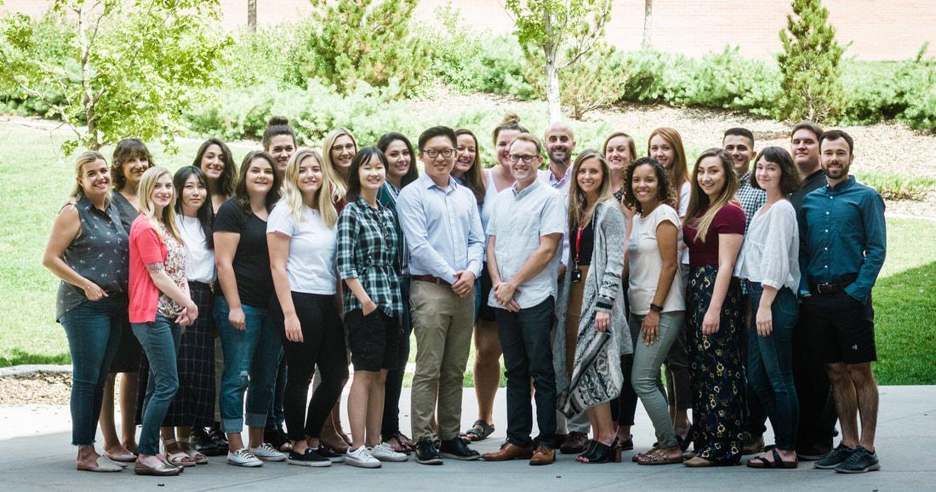
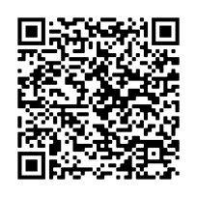

www.u-tteclab.com
Additional Questions: morgan.hutchinson@u-tteclab.com

